Slide 1
Rice Crop Disease Prediction
BY
Navin Kumar
Sachin
THilak

Slide 2
Problem Statement
The proposed Smart Paddy Pest Management model is based CN network. The developmental approach of the proposed system includes two modules:
Disease Identification : Identification of disease affected
Disease Management: Remedial measure for disease Identification is all about detecting what type of infection is occurred in the paddy crop.

Slide 3
Data Collection
Steps:
The dataset was created by manually separating infected leaves into different disease classes.
We had consulted the farmers and had asked them to provide names of diseases for sample leaves.
Image Format: .jpg, The images were captured with a white background, in direct sunlight. The images were reduced to the desired resolution for processing.

Slide 4
METHEDOLOGY
Disease Identification Algorithm
For detecting various paddy crop diseases of Nematode,Blast, Smut, Spots the image processing techniques namely image acquisition, image segmentation, preprocessing feature extraction and classification of image are introduced.
A. Image acquisition
Diseased affected paddy image is captured through a clear camera. To find the exact disease affected, the RGB color of the cropped image is must be clearly visible.

Slide 5
METHEDOLOGY
B. Image preprocessing
The basic idea of the procedure is to upgrade the picture information and enhance the image properties. Image pre-processing is basic for showing, putting away and transmission off picture.
C. Image segmentation
The image quality is affected by the intensity of camera, flash, external environment factors such as ambient light, frequency distortion etc. These factors act as noise in images. They can be removed by using the deep convolutional neural network CNN algorithm.
The deep-convolutional network algorithm is used for noise reduction process of disease identification in paddy crops.

Slide 6
METHEDOLOGY
D. Feature extraction
The paddy leaf disease consists of different lesion shape and lesion color because of several types of disease such as Nematode, Blast, Smut, and Spots. Features such as shape, color play a major role in disease identification. Shape can be identified by measuring the breadth and height of the paddy diseased image to measure the object pixel count.
E. Image classification
Several classification methodologies like Bayesian, artificial neural network [ANN], . The training dataset is analyzed using deep CNN to extract its features and haracteristics for comparison with the testing dataset.

Slide 7
Data Modelling:
Algorithm: Paddy crop disease classification using deep CNN.
Input: Paddy crop colored diseased images.
Output: Classified diseased images & Preventive Measures.
Step 1: Start.
Step 2: Train the 200 selected images with deep CNN and obtain the features for pattern matching.
Step 3: Select the colored image of a specific disease from testing database.
Step 4: Crop multiple diseased spot from the image and choose the ideal one.
Step 5: Apply deep CNN algorithm for images denoising
Step 6: Apply color and texture feature extraction
Step 7: Train the color and texture feature with classifier
Step 8: Determine and classify the images using deep CNN
Step 9: Highlight the disease affected and remedial measures
Step 10: Stop.

Slide 8
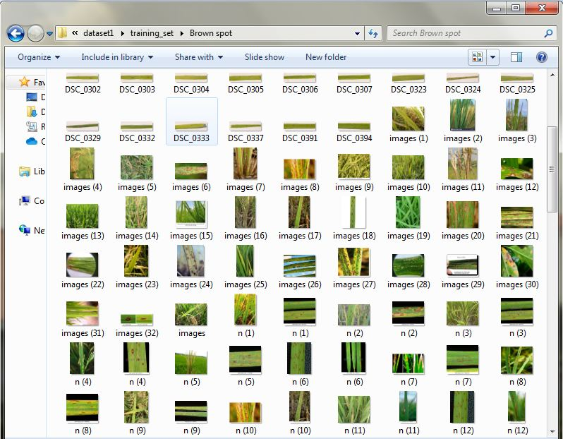
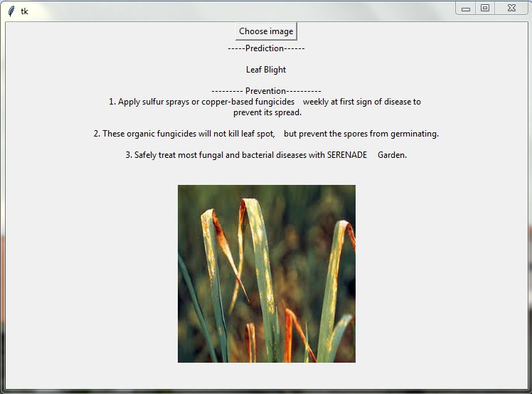
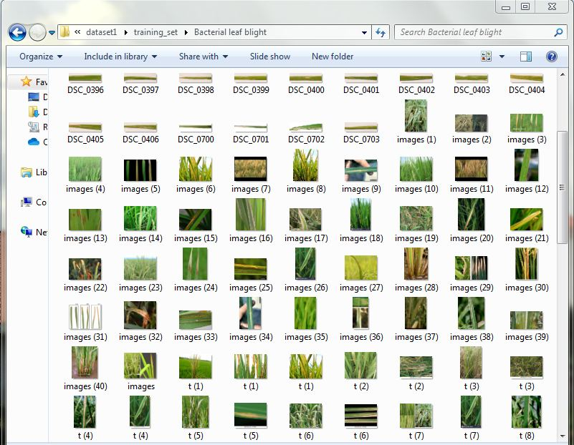
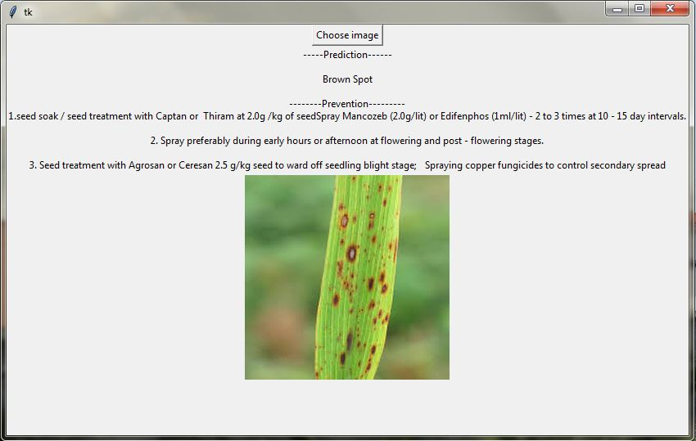
Data Modeling

Slide 9
CONCLUSION
The drastic environment change urges the need of devising new methodology for agriculture i.e. paddy crop plantation. In this paper, we proposed a new mobile app based on ML algorithms for defining diseases identification and classification in paddy crops. The deep CNN is used for denoising images classification is used for disease classification.
It is found that the proposed methodology has evidenced to achieve improved classification with an accuracy of 98.30 %. The research work can further extended to reduce the false classification by using other classifiers for feature extraction among the various paddy crop diseases

